Slide 1


Train Ticket generation
Using Spring
Boot​
Anjana Shankar
Bharath Lakshmi
Jeswanth Ragu
Krishna Raju
Sinchana Puttaswamy
Group 3

Slide 2
Spring Boot
Spring Framework is a widely used Java EE framework for building applications.
Spring Boot Framework is widely used to develop REST APIs.
It aims to simplify Java EE development that makes developers more productive.
It aims to shorten the code length and provide the easiest way to develop Web Applications.

Slide 3
Why Spring Boot
It provides a flexible way to configure Java Beans, XML configurations, and Database Transactions.
It provides a powerful batch processing and manages REST endpoints.
In Spring Boot, everything is auto configured; no manual configurations are needed.
It offers annotation-based spring application
Eases dependency management

Slide 4
CASE STUDY
This Case Study involves generating a train ticket and printing the ticket to a File.
The application should take train number and passenger details as input.
The details of the train should be stored in a database.
The train details to be stored in database are Train number, Train Name, Source Station, Destination Station and Ticket Price. The train details should be fetched from the database using the train number provided by the user.
The passenger name, age and gender should be accepted from the user.
The application should generate a train ticket using the train details and passenger details.
The generated ticket should contain the following details
PNR Number, Travel date, Train Number, Train Name, Source Station, Destination Station
Name, age, gender and ticket fare for each passenger
Total Ticket price
The generated ticket should be written to a File.

Slide 5

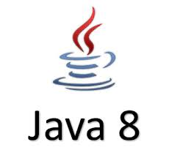
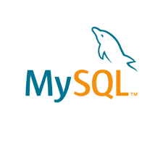



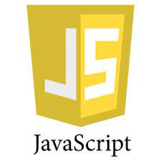
SYSTEM REQUIREMENTS

Slide 6
UNDERSTANDING pom.xml
<?xml version="1.0" encoding="UTF-8"?>
<project xmlns="http://maven.apache.org/POM/4.0.0" xmlns:xsi="http://www.w3.org/2001/XMLSchema-instance"
xsi:schemaLocation="http://maven.apache.org/POM/4.0.0 https://maven.apache.org/xsd/maven-4.0.0.xsd">
<modelVersion>4.0.0</modelVersion>
<parent>
<groupId>org.springframework.boot</groupId>
<artifactId>spring-boot-starter-parent</artifactId>
<version>2.5.6</version>
<relativePath/> <!-- lookup parent from repository -->
</parent>
<groupId>com.torryharris</groupId>
<artifactId>New_Train</artifactId>
<version>0.0.1-SNAPSHOT</version>
<name>New_Train</name>
<description>New_Train</description>
<properties>
<java.version>1.8</java.version>
</properties>

Slide 7
DEPENDENCY ADDED IN pom.xml
<dependency>​
<groupId>org.springframework.boot</groupId>​
<artifactId>spring-boot-starter-data-jdbc</artifactId>​
</dependency>
Spring data JDBC
<dependency>
<groupId>org.springframework.boot</groupId>
<artifactId>spring-boot-starter-data-jpa</artifactId>
</dependency>
Spring data JPA
<dependency>
<groupId>org.springframework.boot</groupId>
<artifactId>spring-boot-starter-web</artifactId>
</dependency>
Spring Web

Slide 8
<dependency>
<groupId>org.apache.tomcat</groupId>
<artifactId>tomcat-jasper</artifactId>
<version>9.0.54</version>
</dependency>
Tomcat jasper
<dependency>
<groupId>mysql</groupId>
<artifactId>mysql-connector-java</artifactId>
</dependency>
MySql Connector
<dependency>
<groupId>org.projectlombok</groupId>
<artifactId>lombok</artifactId>
<optional>true</optional>
</dependency>
Lombok

Slide 9
PLUGINS USED IN pom.xml
<build>
<plugins>
<plugin>
<groupId>org.springframework.boot</groupId>
<artifactId>spring-boot-maven-plugin</artifactId>
<configuration>
<excludes>
<exclude>
<groupId>org.projectlombok</groupId>
<artifactId>lombok</artifactId>
</exclude>
</excludes>
</configuration>
</plugin>
</plugins>
</build>

Slide 10
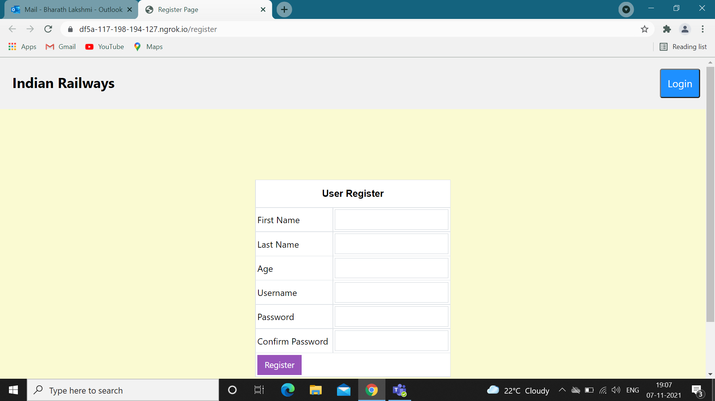
REGISTER PAGE

Slide 11
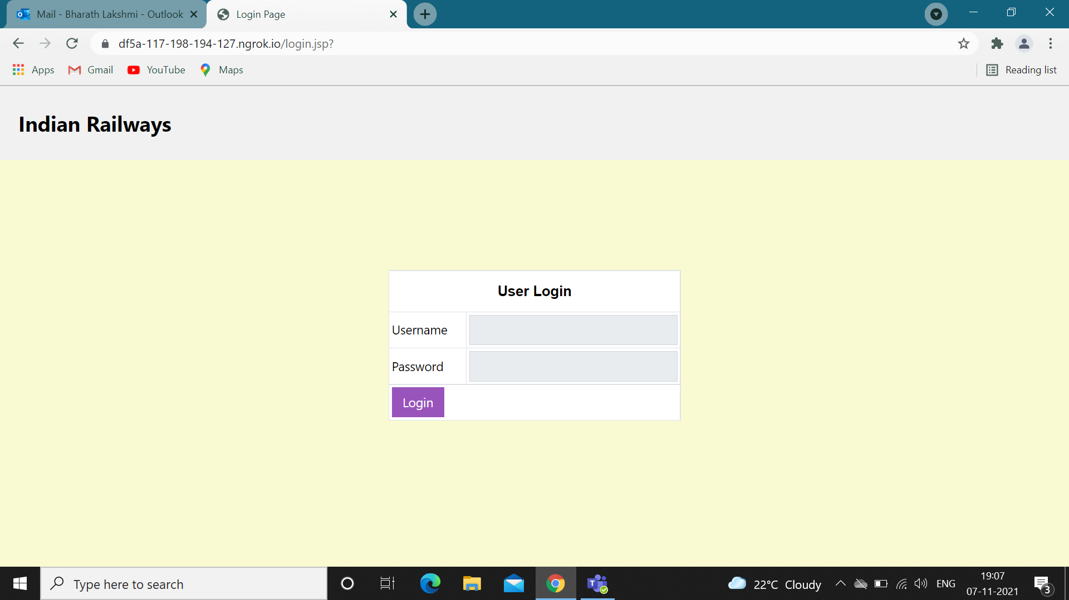
LOGIN PAGE

Slide 12
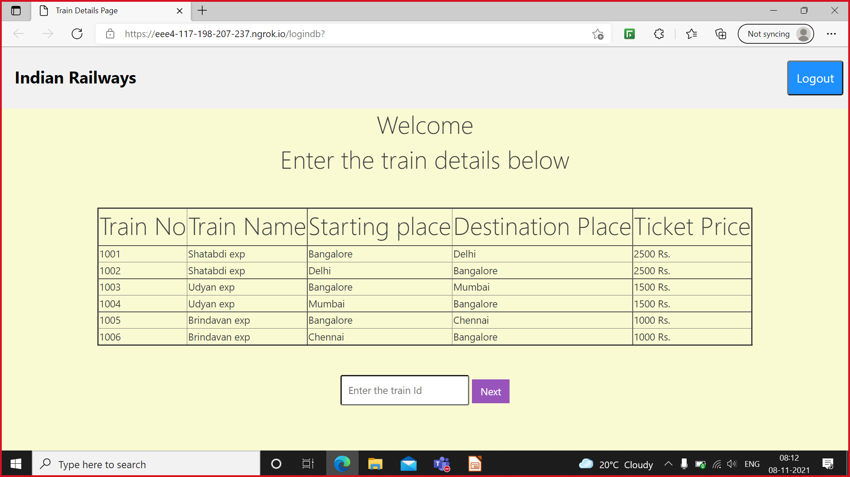
TRAIN DETAILS PAGE

Slide 13
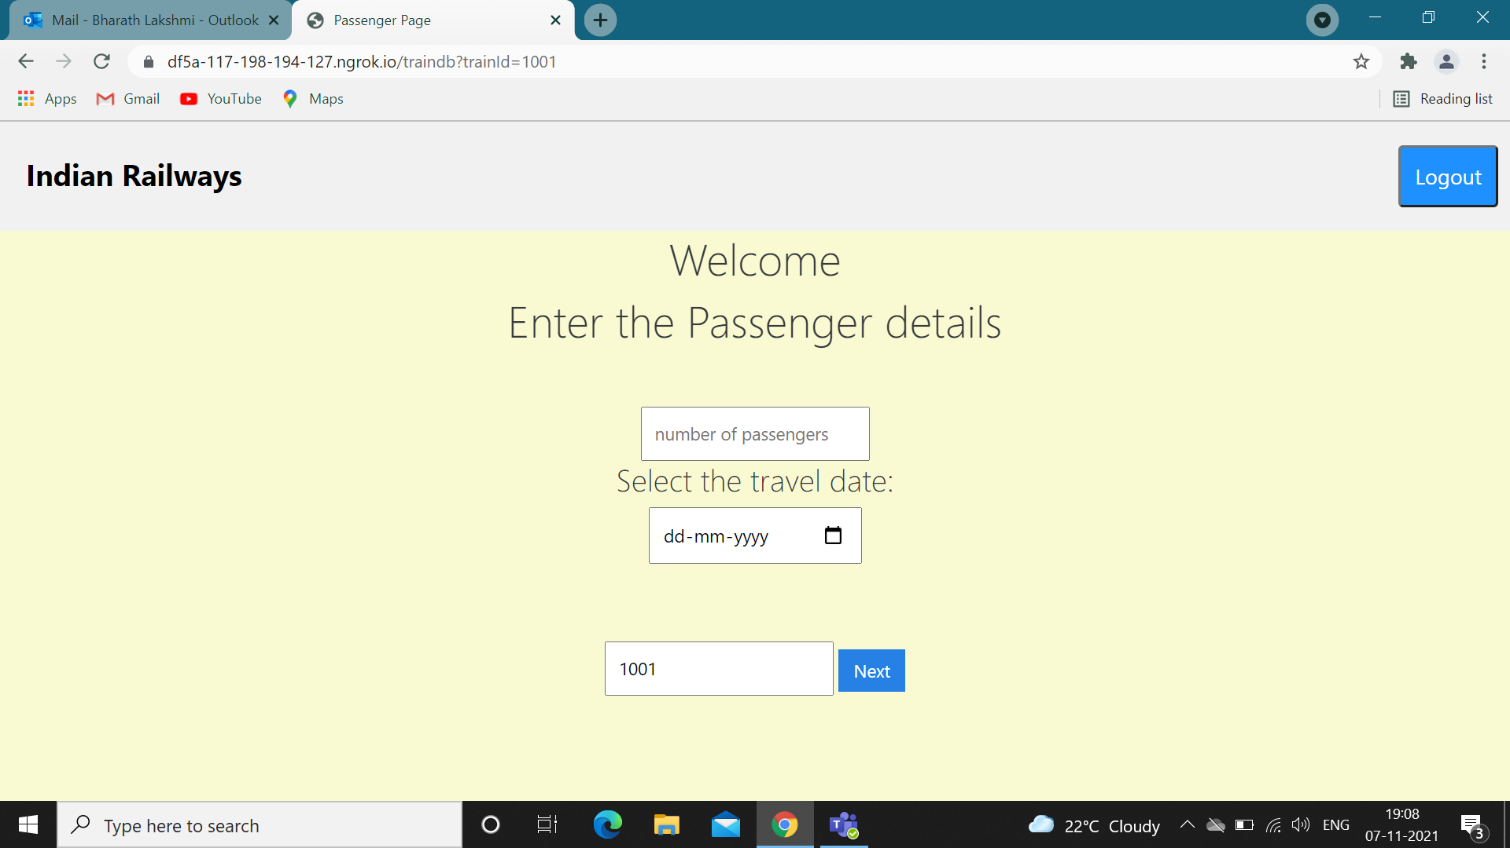
ENTERING PASSENGER DETAILS

Slide 14
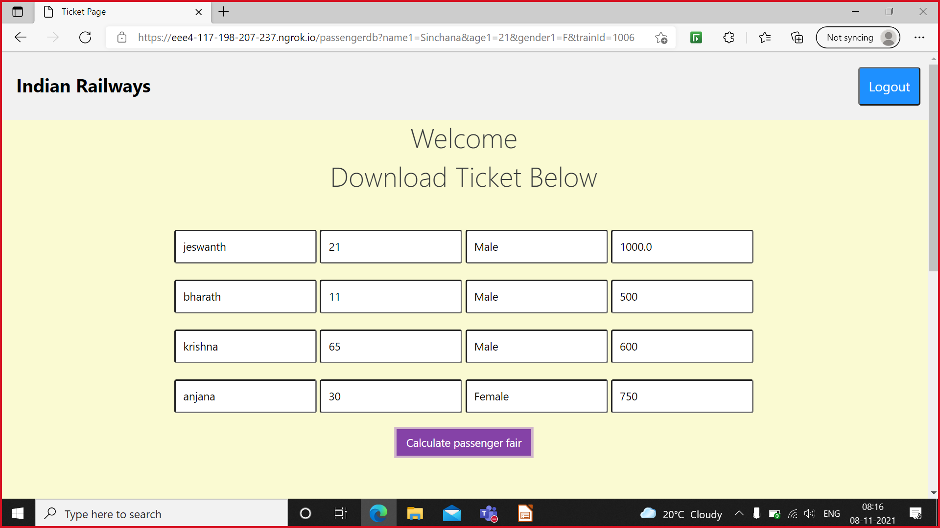
CALCULATING PASSENGER FAIR

Slide 15
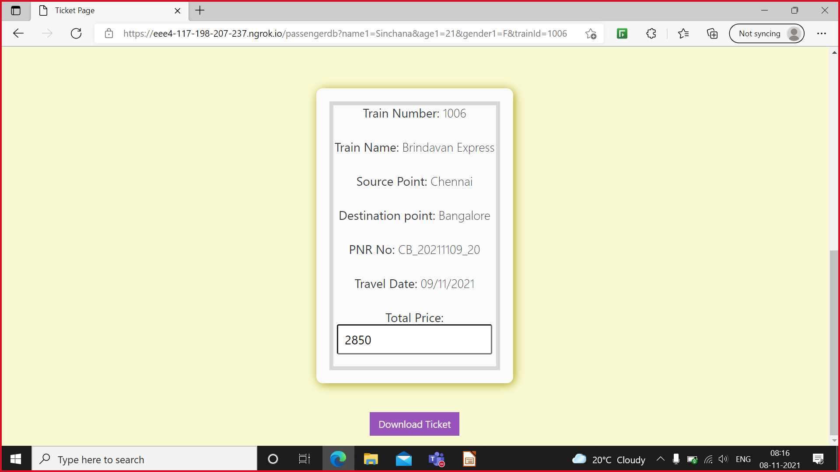
DOWNLOADING THE TICKET

Slide 16
THANK YOU

